Slide 1

Regular Expressions
SoftUni Team
Technical Trainers
Software University
https://softuni.bg

Slide 2
Table of Contents
Definition
Syntax
RegEx in Python
RegEx Method
2

Slide 3
Have a Question?
sli.do
#fund-python

Slide 4

What is RegEx?

Slide 5
What is RegEx?
A regular expression or regex is a sequence of characters that define a search pattern
Usually, such patterns are used by string searching algorithms for "find" or "find and replace" operations on strings
Regular expressions are used in search engines, search and replace dialogs of word processors and text editors etc
5

Slide 6
Example
For example, if you want to validate if an email is valid, it should follow these rules:
have only alphanumeric characters
include "@"
end with .com/.bg/.net
To validate emails will be very difficult without regular expression
6

Slide 7
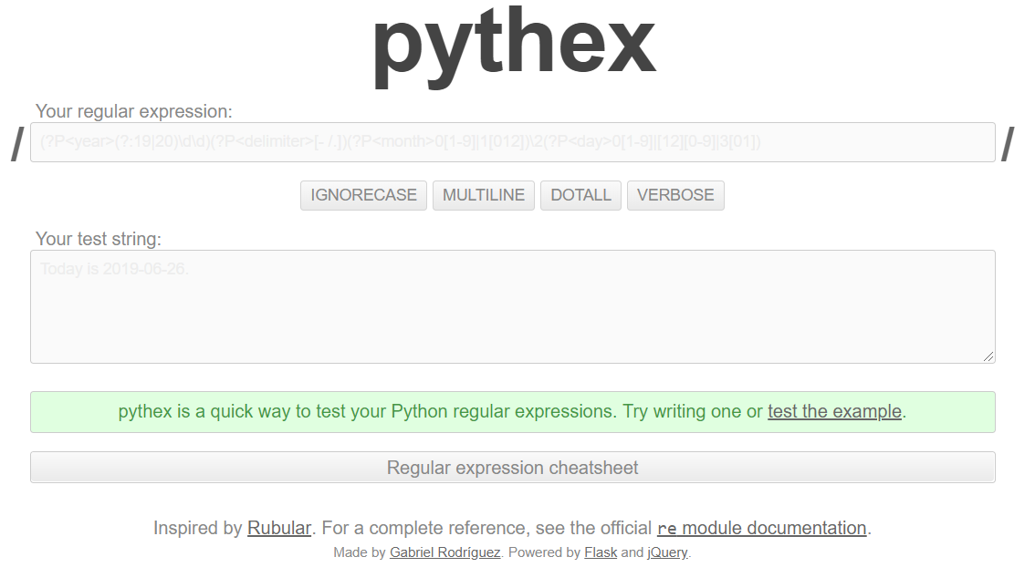
Pythex
To test Regular Expressions in Python, use pythex

Slide 8
Syntax
[A-Z]

Slide 9
Special Sequences
Notation | Meaning
\d | Returns a match where the string contains digits (numbers from 0-9)
\D | Returns a match where the string DOES NOT contain digits
\b | Returns a match where the specified characters are at the beginning or at the end of a word
\s | Returns a match where the string contains a white space character
\S | Returns a match where the string DOES NOT contain a white space character
\w | Returns a match where the string contains any word characters (characters from a to Z, digits from 0-9, and the underscore _ character)
\W | Returns a match where the string DOES NOT contain any word characters
9

Slide 10
Metacharacters
Notation | Meaning
\ | Signals a special sequence (can also be used to escape special characters)
. | Any character (except newline character)
+ | One or more occurrences
* | Zero or more occurrences
| | Either or
() | Capture and group
{} | Exactly the specified number of occurrences
^ | Starts with
$ | Ends with
10

Slide 11
Sets
Examples | Meaning
[arn] | Returns a match where one of the specified characters (a, r, or n) are present
[a-n] | Returns a match for any lower-case character, alphabetically between a and n
[^arn] | Returns a match for any character EXCEPT a, r, and n
[0123] | Returns a match where any of the specified digits (0, 1, 2, or 3) are present
[0-9] | Returns a match for any digit between 0 and 9
[0-5][0-9] | Returns a match for any two-digit numbers from 00 and 59
[a-zA-Z] | Returns a match for any character alphabetically between a and z, lower case OR upper case
11

Slide 12
Problem: Match All Words
Write a regular expression in pythex that extracts all word char sequences from given text
_ (Underscores) are also word characters!
_|Underscores|are|also|word|characters

Slide 13
Problem: Match Dates
Write a regular expression that extracts dates from text
Valid date format: dd-MMM-yyyy
Examples: 12-Jun-1999, 3-Nov-1999
I am born on 30-Dec-1994.
My father is born on the 9-Jul-1955.
01-July-2000 is not a valid date.

Slide 14
Problem: Email Validation
Write a regular expression that performs simple email validation
An email consists of: username @ domain name
Usernames are alphanumeric
Domain names consist of two strings, separated by a period
Domain names may contain only English letters
Valid:
Invalid:
valid123@email.bg
invalid*name@emai1.bg

Slide 15
RegEx in Python
import re

Slide 16
RegEx Module
Python has a built-in package called re
It can be used to work with Regular Expressions
Import the re module
Use it to search in text
import re
import re
txt = "The rain in Spain"
x = re.search("^The.*Spain$", txt)
16

Slide 17

RegEx Methods

Slide 18
findall() method
The findall() function returns a list containing all matches
The list contains the matches in the order they are found
If no matches are found, an empty list is returned
import re
str = "The rain in Spain"
x = re.findall("ai", str)
print(x) # ["ai", "ai"]
18

Slide 19
Problem: Match Full Name
You are given a list of names
Match all full names
Bethany Taylor, Oliver miller, sophia Johnson, SARah Wilson, John Smith, Sam Smith
Bethany Taylor John Smith

Slide 20

Solution: Match Full Name
import re
names = input()
regex = "\\b[A-Z][a-z]+ [A-Z][a-z]+\\b"
matches = re.findall(regex, names)
print(" ".join(matches))
20

Slide 21
Problem: Match Phone Number
You are given a list of phone numbers
Match all valid phone numbers
+359 2 222 2222,359-2-222-2222, +359/2/222/2222, +359-2 222 2222 +359 2-222-2222, +359-2-222-222, +359-2-222-22222 +359-2-222-2222
+359 2 222 2222, +359-2-222-2222

Slide 22

Solution: Match Phone Number
import re
pattern = "(\+359-2-[0-9]{3}-[0-9]{4}|\+359 2 [0-9]{3} [0-9]{4})\\b"
text = input()
matches = re.findall(pattern, text)
print(", ".join(matches))
22

Slide 23
Problem: Match Dates
Write a program, which matches a date in the format "dd{separator}MMM{separator}yyyy"
Use capturing groups in your regular expression
13/Jul/1928, 10-Nov-1934, , 01/Jan-1951,f 25.Dec.1937 23/09/1973, 1/Feb/2016
Day: 13, Month: Jul, Year: 1928 Day: 10, Month: Nov, Year: 1934 Day: 25, Month: Dec, Year: 1937
23

Slide 24
Solution: Match Dates
import re
pattern = "\\b(?P<day>\\d{2})([-.\\/])(?P<month>[A-Z] [a-z]{2})\\2(?P<year>\\d{4})\\b"
text = input()
matches = re.finditer(pattern, text)
for match in matches:
print(f"Day: {match.group('day')}, Month: {match.group('month')}, Year: {match.group('year')}")
24

Slide 25
search() method
The search() function searches the string for a match, and returns a Match object if there is a match
If there is more than one match, only the first occurrence of the match will be returned
If no matches are found, the value None is returned
import re
str = "The rain in Spain"
x = re.search("\s", str)
print("The first white-space character is located in position:", x.start())
25

Slide 26

split() method
The split() function returns a list where the string has been split at each match
import re
str = "The rain in Spain"
x = re.split("\s", str)
print(x)
# ['The', 'rain', 'in', 'Spain']
26

Slide 27

Live Exercises

Slide 28

Summary
A regular expression or regex is a sequence of characters that define a search pattern
Python has a built-in package called re
It can be used to work with Regular Expressions
…
…
…

Slide 29
Questions?
Notes:
29

Slide 30












SoftUni Diamond Partners

Slide 31


Educational Partners

Slide 32
Trainings @ Software University (SoftUni)
Software University – High-Quality Education, Profession and Job for Software Developers
softuni.bg, softuni.org
Software University Foundation
softuni.foundation
Software University @ Facebook
facebook.com/SoftwareUniversity
Software University Forums
forum.softuni.bg
32
Notes:
32

Slide 33

License
This course (slides, examples, demos, exercises, homework, documents, videos and other assets) is copyrighted content
Unauthorized copy, reproduction or use is illegal
© SoftUni – https://softuni.org
© Software University – https://softuni.bg
Notes:
33

